Slide 2
HPSM Ticket Booking Process

Slide 3
V!PAM LOGIN (via Browsers)
1. Once Active X / Agent is installed from below links, close Internet Explore / Chrome / Firefox.
V!PAM PLUGIN Agent : https://V!PAM.vodafoneidea.com/ARCOSClientDownloadHelp/Downloadables/ARCON%20PAM%20Plugin%20Setup.msi
Active X:
https://V!PAM.vodafoneidea.com/ARCOSClientManagerActiveX/Setup/ARCOSClientManagerActiveXSetup.msi
2. Re-launch the V!PAM URL using link below:
URL: - https://V!PAM.VODAFONEIDEA.COM

Slide 4
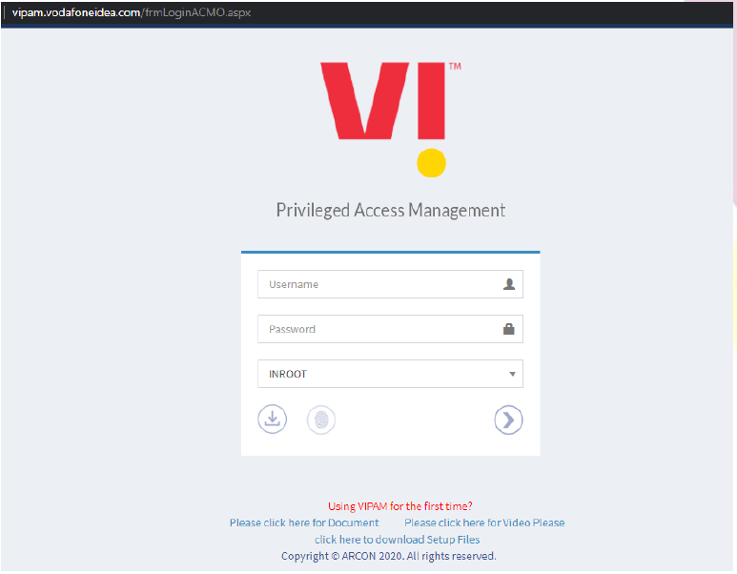
VIPAM Login Page
Login URL: https://vipam.vodafoneidea.com/frmLoginACMO.aspx
Login to application with your AD credentials.
Enter the domain ‘Username’ and ‘Password’.
Select Domain ‘INROOT’
Click on Login Button

Slide 5
VIPAM Login Page

Slide 6
V!PAM LOGIN (via Thick Client)
User can also launch V!PAM using V!PAM Thick Client by following below steps:
Link to download V!PAM Thick Client:
https://V!PAM.vodafoneidea.com/ARCOSClientDownloadHelp/Downloadables/ARCON%20PAM.msi
Step 1 : First Launch V!PAM URL in any browser and click on downloadable button as shown

Slide 7
V!PAM LOGIN (via Thick Client)
Step 2 : It will route you to new tab from where user can download V!PAM Thick client

Slide 8
V!PAM LOGIN (via Thick Client)
Step 3: Click on Thick Client to download it.

Slide 9
V!PAM LOGIN (via Thick Client)
Step 4: Launch V!PAM thick Client after downloading and type V!PAM Url here

Slide 10
V!PAM LOGIN (via Thick Client)
Step 5: Click on OK, now the Login Screen will appear

Slide 11
V!PAM LOGIN (via Thick Client)
Step 6: Enter your login credentials here and click on Login Button

Slide 12
VIPAM Home Page
Once you are successfully logged in you will get the below is the welcome screen:

Slide 13
My Services
You can use the filters for finding the servers/services allocated to you.
LOB: You need to select the LOB depending upon the Location of Target Device/Server and Service type after that click on search Tab.
ASM

Slide 14
Service Type
Service Type : Once you have selected the Location, then you can use the Service Type for more filter or enter the Host Name/IP Address of the Server for that particular location

Slide 15
IP Address/Host Name
IP Address / Host Name : User can simply search any server by putting IP Address or Host Name as below shown:

Slide 16
Search
Search: User can also do random search by putting any random data in Search TAB shown below:

Slide 17
All Services
You can check mark All Services Tab for listing all assigned services to logged In User in V!PAM.

Slide 18
Connection
Connection: Click on the connect button at right most of that service that you want to access.

Slide 19
Welcome Screen Details
More Precise Details of Servers listed on Welcome screen i.e. Complete Name, Profile Group, Circle, etc.
Complete Name: Here you can able to see complete detail of particular servers such as Location, Device Name, Device Type, etc.
Profile Group: Here you can see in which group and user profile type it is mapped.
Circle: Here you can see the location of particular device or server.

Slide 20
MY TAGS
Tags - We can use tags to narrow down our search for a specific service. Click on (+) icon to create a new tag, say ‘daily use servers’

Slide 21
MY TAGS
Once a tag is created we can then assign this specific tag to individual services that we like (As shown below). After Clicking the highlighted icon assign the tag that we created by selecting it from the dropdown.

Slide 22
MY TAGS
Now we can filter out the services based on our assigned tags. This will ease our day today task of taking connection to different kind of services.

Slide 23
Service Assigned
After completing the required service search you will come across a icon highlighted as below. This icon (Lock) represents that the service is assigned to you on a permanent basis and will be available for access.

Slide 24
Thank you !

